Slide 1

ELEC ENG499 Comparing Numerical Solvers and Physics-Informed Neural Networks for the Damped Harmonic Oscillator
Yiming Ma
Net ID: EFY1458
3/9/2026
Notes:
Hello everyone. My name is Yiming Ma. Today I will present my project on comparing classical numerical solvers and a physics-informed neural network for the damped harmonic oscillator. The goal of this project is to study how well different methods solve a simple dynamical system, and to compare their accuracy and behavior.”

Slide 2
Problem and motivation
What is the problem?
A classical second-order dynamical system
Appears in vibration, mechanics, and circuits
Oscillation amplitude decays because of damping
Project goal
Compare Euler, RK4, and PINN
Evaluate accuracy and limitations
Notes:
The damped harmonic oscillator is a classical system that appears in many areas such as mechanical vibration, structural dynamics, and electrical circuits. Because of the damping term, the oscillation amplitude decreases over time. In this project, I compare three methods: Euler, RK4, and a simple PINN. I focus on their accuracy and on the difference between classical numerical methods and scientific machine learning. The damped harmonic oscillator is a good benchmark problem because the physics is simple enough to understand, but still rich enough to show meaningful differences between methods. It has a clear oscillatory structure, damping behavior, and an analytical interpretation. This makes it a useful starting point for comparing traditional numerical solvers with scientific machine learning approaches. I also chose this problem because it allows us to focus on method behavior without the complication of a very large system.

Slide 3
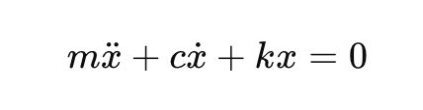
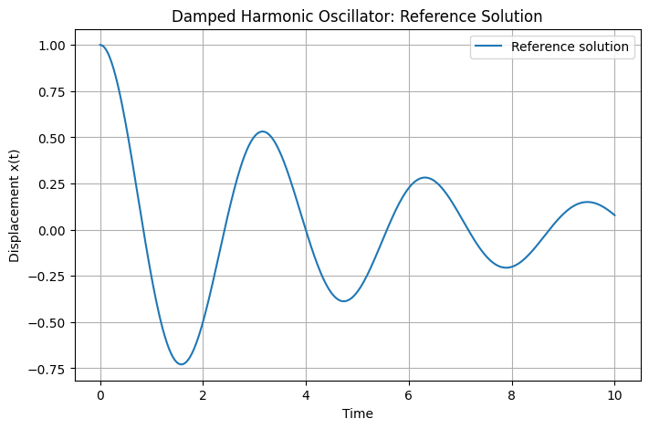
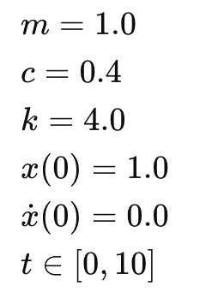
Governing equation and setup
Notes:
The system is governed by a second-order ordinary differential equation, where m represents the mass, c is the damping coefficient, and k is the spring constant. In this project, I used the specified parameter values together with the initial conditions x(0) = 1 and x'(0) = 0.x at zero equals one, and x prime at zero equals zero. The figure on the right shows the reference solution. It can be seen that the system exhibits an underdamped oscillation with an amplitude that gradually decreases over time. This is an underdamped system, which means the solution still oscillates, but the amplitude gradually decreases over time because of energy loss from damping. This is important for testing numerical methods, because a good method should capture both the oscillation frequency and the decay of amplitude. If the method is not accurate enough, it may distort the phase, the amplitude, or both.

Slide 4
Classical Numerical Methods
Method | Idea | Expected Accuracy
Euler | simple first-order update | Lower
RK4 | higher-order step integration | Higher
Reference solution generated by SciPy solve_ivp
Notes:
For the classical numerical methods, I first rewrote the second-order ODE as a first-order system. Then I implemented Euler and RK4. Euler is simple and easy to implement, but its accuracy is lower. RK4 is a higher-order method, so it is generally more accurate. I used SciPy’s solve_ivp to generate the reference solution for comparison.”To apply standard ODE solvers, I first converted the second-order equation into a first-order system by introducing velocity as a second variable. This is a common step because many numerical ODE methods are naturally written for first-order systems. Euler uses only local slope information at the current step, so it is simple but may accumulate error quickly. In contrast, RK4 evaluates the slope multiple times within one step, which usually gives a much better approximation. I used SciPy’s solve_ivp as a reference because it provides a reliable baseline for comparison.

Slide 5
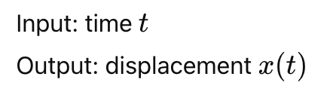
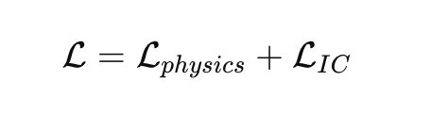
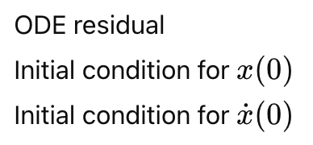
Method: PINN
PINN idea
loss includes
Notes:
For the scientific machine learning part, I implemented a simple physics-informed neural network, or PINN. The network takes time as input and predicts displacement as output. Instead of fitting many labeled data points, the PINN is trained by minimizing a loss function that combines the ODE residual and the initial conditions. In this way, the model learns a solution that is physically consistent. A key difference from standard supervised learning is that the PINN does not mainly rely on many labeled solution points. Instead, it uses the governing equation itself as part of the training signal. This is appealing because in many scientific problems, collecting data may be expensive, but the physical law is already known. At the same time, training a PINN can be more challenging because the optimization problem is more complicated, and balancing different loss terms is not always easy.

Slide 6
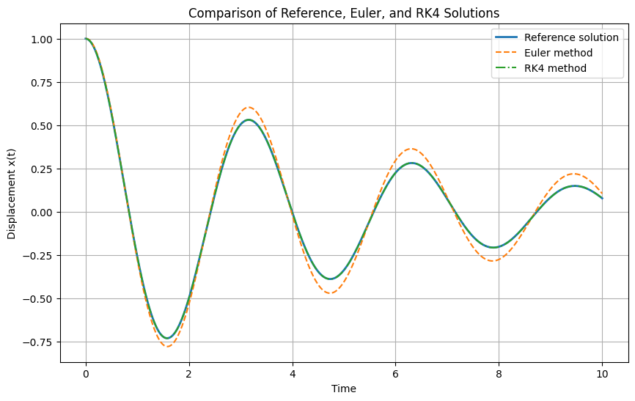
Result: Classical solvers
Euler | 2.51×10⁻³
RK4 | 3.04×10⁻⁷
Notes:
This figure compares the reference solution with Euler and R K four.
Both methods capture the oscillation trend, but R K four follows the reference much more closely.
The M S E results show this clearly.
Euler has an M S E of about 2.51×10⁻³
, while R K four has an M S E of about 3.04×10⁻⁷.
So, for this problem, R K four is much more accurate than Euler. From the plot, we can see that both methods capture the overall oscillatory pattern, which means both are qualitatively correct. However, Euler begins to drift away from the reference more noticeably. This likely happens because its local approximation is much less accurate, so the error accumulates over time. The much smaller MSE for RK4 confirms that it preserves the trajectory much better across the full time interval.

Slide 7
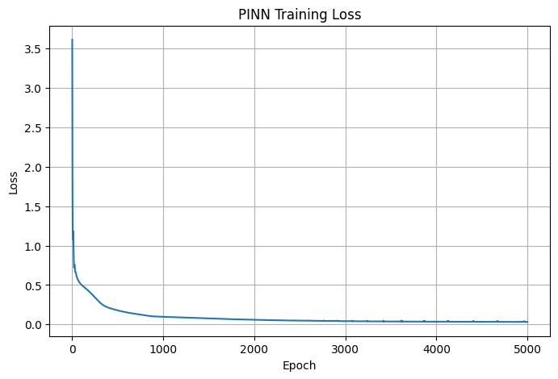
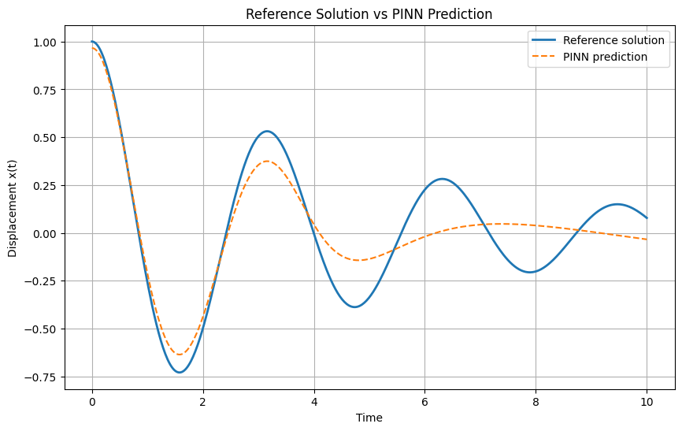
Result: PINN
PINN | 2.6×10⁻²
Notes:
This figure shows the PINN prediction compared with the reference solution. The PINN learned the general damped oscillatory trend, especially in the earlier part of the trajectory. However, the prediction deviates more at later times. The final PINN MSE is about
2.6*10-2, which is larger than both Euler and RK4 in this experiment. So the simple PINN captured the qualitative behavior, but its quantitative accuracy was limited. Even though the quantitative accuracy is limited, the PINN still learned the main physical pattern: oscillation together with decaying amplitude. So it is not a complete failure; rather, it captures the qualitative behavior better than the final MSE alone might suggest. One reason the performance may be limited is that this was a relatively simple PINN setup. Better tuning, a different network architecture, more training iterations, or improved loss weighting might improve the result.

Slide 8
Conclusion
RK4 gave the best accuracy
Euler captured the trend but had larger error
PINN learned the qualitative behavior
Classical solvers remain stronger for simple ODEs
PINNs may be useful for more complex problems
Notes:
In conclusion, RK4 produced the most accurate solution by a large margin. Euler captured the overall trend but accumulated larger numerical error. The PINN learned the qualitative damped oscillatory behavior, but it was less accurate than the classical methods in this simple case. Overall, this project shows that classical numerical solvers remain very effective for simple ODEs, while PINNs provide a flexible scientific machine learning framework that may become more useful in more complex settings. Although PINN was less accurate in this simple problem, it is still worth exploring because it can be useful when data are limited, the physics must be enforced, or traditional solvers are difficult to apply. One takeaway from this project is that the best method depends strongly on the problem type. For a simple low-dimensional ODE like this one, classical numerical solvers are hard to beat in efficiency and accuracy. But PINNs are still interesting because they may become more useful when data are scarce, when physical constraints are important, or when we move to more complex systems where traditional approaches become harder to apply.Thank you.”

